Slide 1


Project 1
The Cutlery Group

Slide 2
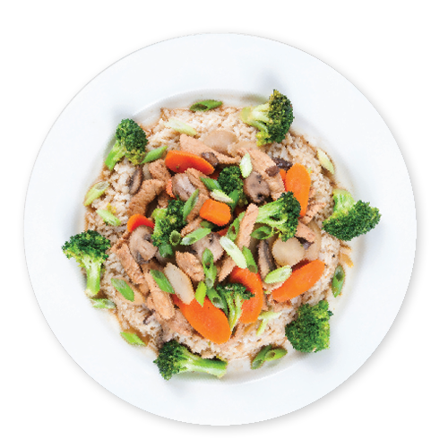
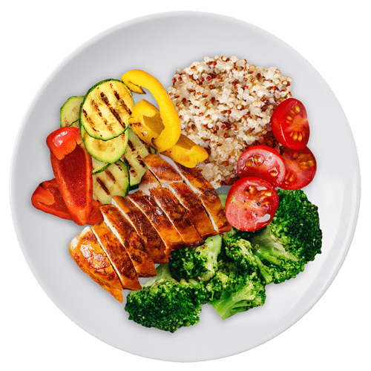
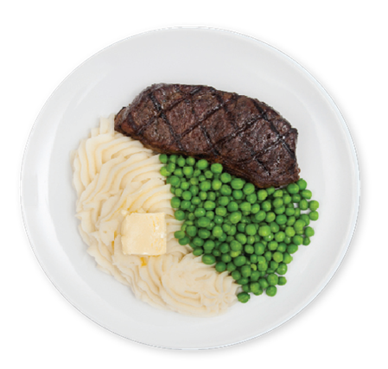
Agenda
Introduction
Data Cleaning
Presentation of Data
Summary

Slide 3
Introduction
The Cutlery Group conducted analysis to determine whether ratings supported food quality. This analysis was conducted utilizing Google API for restaurant data and US city population data.
Team Member | Role
Sanjay Dabra | Code Build and Visualization
Jeffrey Frazier | Code Research and PowerPoint Creation
Matthew Ward | Code Build and Visualization

Slide 4
Questions to be answered:
Does pricing influence ratings?
Does pricing influence the number of reviews?
Does population influence rating?
Does population affect the number of reviews?

Slide 5

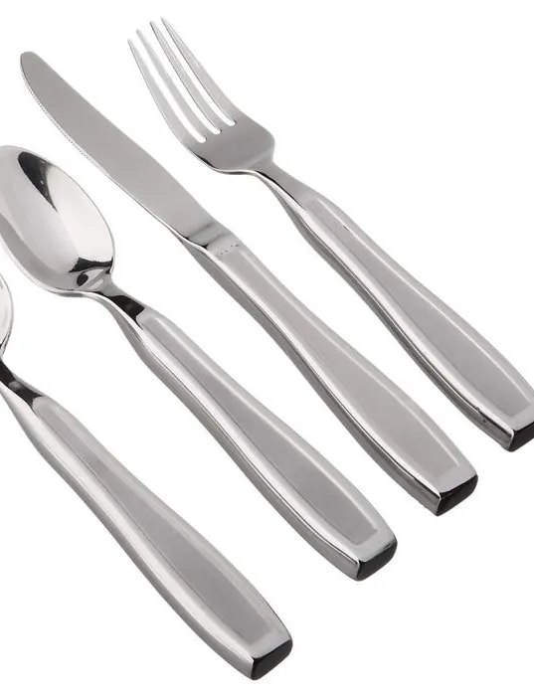
Data Cleaning

Slide 6
Data Cleaning
Pulled city populations from World Population Review (worldpopulationreview.com)
Pulled restaurant information from Google API
Filtered cities by population (>1,000,000) and randomly pulled 10 cities
Filtered restaurants by Rating (>4.0) and Number of Reviews (>250)
Notes:
World population gave population size with latitudes and longitudes which allowed a merge into the Google API
Google API was used since it contained the rating and review information desired for analysis
The reason for 10 cities is to show proof of concept before expanding
-Quantify if correlation truly exists, costs deemed starting with 10 then expanding nation wide
Filtered restaurants to focus on a rating above 4.0 to differentiate between a good review and great review
>250 reviews give restaurants with a well established review base and reputation

Slide 7
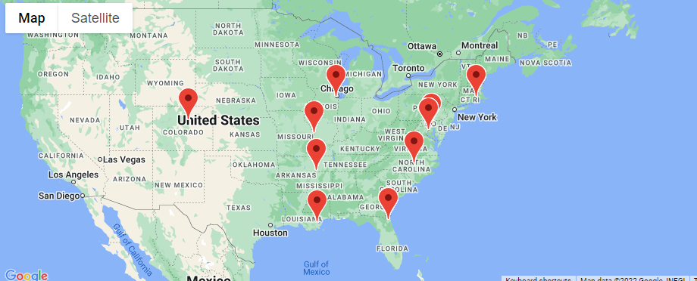
Location of Cities

Slide 8
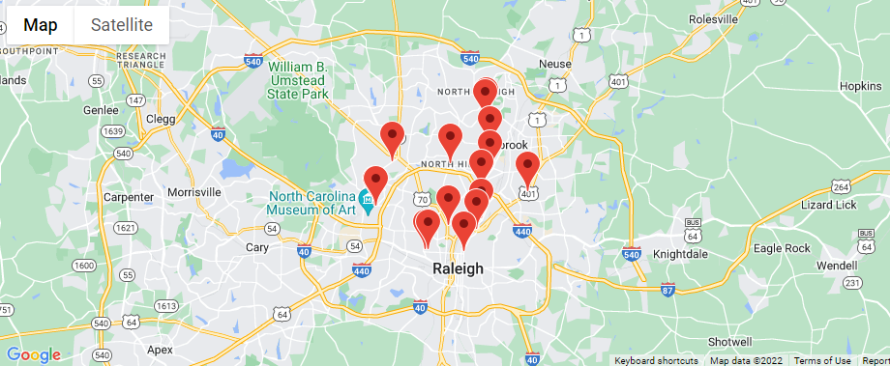
Restaurants in Cities
Notes:
5 km radius

Slide 9
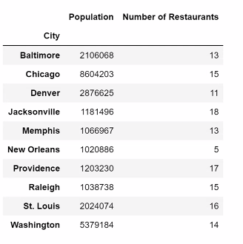
Number of Restaurants for Each City

Slide 10
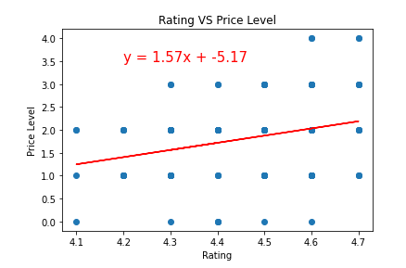
Does price level influence ratings?
R-Square Value is: 0.28
Weak Positive Correlation

Slide 11
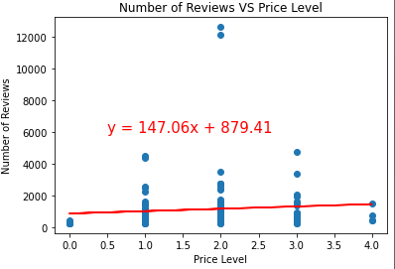
Does pricing influence the number of ratings?
R-Square Value is: -0.21
Weak Negative Correlation

Slide 12
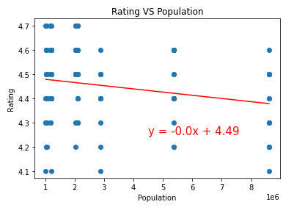
Does Population affect the rating?
R-Square Value is: -0.20
Very Weak Negative
Correlation

Slide 13
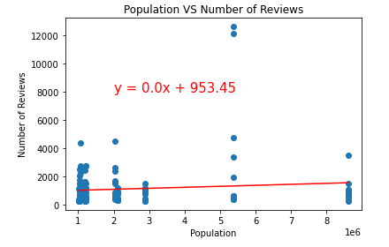
Does Population affect the number of reviews?
R-Square Value is: 0.28
No Correlation

Slide 14
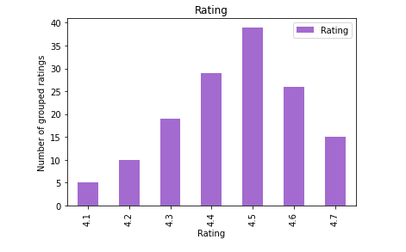
Rating Distribution
Notes:
Most given review was 4.5, data was truly random and well distibuted

Slide 15
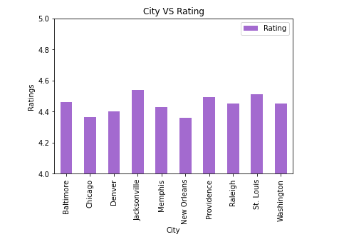

Slide 16
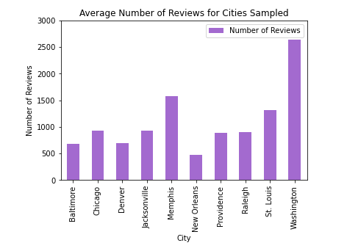

Slide 17

Summary

Slide 18


Thank You

